Slide 1

Chapter 3
Interrupts
Introduction
  An executing program can be interrupted by an external device, or through the direct call of interrupt subroutines.
  No instruction is interrupted during execution. Before the fetching of the next instruction occurs, the interrupt flag is checked and if pending interrupts exists control is automatically transferred to a service routine (interrupt handler).
  Processing requests via interrupts have the desired effect of speeding up service and minimize cpu idle time.
  Interrupts are external if initiated by hardware devices external to the cpu.

Slide 2
  Interrupts initiated by a program or by exceptions are internal (software interrupts).
  Internal interrupts include division by zero, overflow, single step execution, or breakpoints.
  Interrupts may be maskable, i.e., they can be temporarily disabled, or nonmaskable for which a dedicated hardwired signal exists and cannot be disabled.
  Illustration: Suppose a processor reads a character in 10⁻⁵ seconds. If the processor waits say 10 seconds for a user to type a character then (10−10⁻⁵)/10 = .99999 implies that 99.99% of the time the cpu is idle. To minimize idle time, the keyboard must generate an interrupt signal right after the user presses any key.
  Several interrupt signals can be queued and serviced following a pre-assigned scheduling criteria; this allows servicing several devices while attempting to maintain the cpu busy most of the time.

Slide 3
Real mode interrupts
  Devices requesting services send an interrupt request signal to the processor, which acknowledges the request.
  The device responds with an 8-bit number that identifies the interrupting device.
  The cpu uses the interrupt number to access the interrupt vector table (IVT and fetches the address of the interrupt handler. The following steps summarize the actions (interrupt service) that an Intel 8086/88 processor executes in response to an interrupt request:
    (1) Saves the contents of the flag register in the stack (pushf):
        sp ← sp - 2
        [ss:sp] ← Flag register
    (2) Disable interrupts (cli): IF ← 0
    (3) Saves return address:
        Push cs: sp ← sp-2; [ss:sp] ← cs
        Push ip: sp ← sp-2; [ss:sp] ← ip
    (4) Locates interrupt vector in the IVT and updates the cs:ip pair with the address of the interrupt handler (n is the interrupt number):
        cs ← IV T₁₆[4 × n]; ip ← IV T₁₆[4 × n + 2]

Slide 4
  Steps 2-4 are indivisible, i.e., no interrupt is serviced.
  When the handler executes an iret the pair cs:ip is restored and the interrupted program continues execution. Execution steps of an interrupt handler:
    (1) Re-enables interrupts (sti): IF ← 1
    (2) Saves contents of working registers into the stack
    (3) Executes code to service interrupt
    (4) Restores working registers
    (5) Executes an iret:
        ip ← [ss:sp]; sp ← sp+2
        cs ← [ss:sp]; sp ← sp+2
      And restores flags register:
        Flag register ← [ss:sp]; sp ← sp+2
  Enabling interrupts in the first step is necessary because it allows requests with higher priority to interrupt the current service routine.

Slide 5
  Interrupt Vector Table (IVT)
    The IVT refers to a memory section from 00000h to 003FFh in real-mode. The table consists of 256 entries; each entry stores an interrupt vector, which is a pointer to the location of the interrupt handler.
    The interrupt vector is fetched and placed in the cs:ip registers before the interrupt handler takes control of the cpu.
    The interrupt number n is multiplied by 4 to form the correct index where the interrupt vector is located.
    Example: int 21h will result in an index 21h×4 = 84h and
    The offset part of the pointer is at 0084h and 0085h, and the segment part at 0086h and 0087h.
    Access to the IVT is illustrated in Fig. 8.1 for the interrupt execution of int 10h software interrupt.

Slide 6
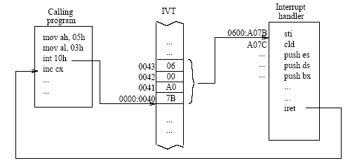
  Figure 8.1: The interrupt execution cycle for int 10h

Slide 7
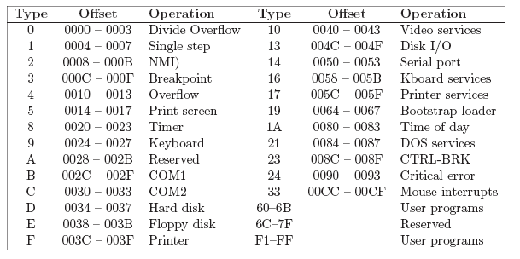
Table 8.1: Selected interrupt vector assignments

Slide 8
Software Interrupts
  software-directed interrupts require specific registers to be pre-loaded with the required parameters.
  One of these parameters is the code function, an 8-bit integer pre-loaded in ah to identify the service expected.
  Common int instructions include:
    int 10h: services video functions,
    int 16h: provides keyboard services,
    int 17h: provides printer services,
    int 1Ah: gets/sets number of ticks from the timer
    int 21h: dos services (I/O, file handler, memory management,etc.),
    Int 31h: dpmi services
    int 33h: mouse operations.

Slide 9
  BIOS Calls
    Software bios is located above the dos area as shown in Table 1.3.
    This area stores procedures that manage most input/output devices including the keyboard, disk drives, video functions, and serial and parallel ports.
    A brief list of the more useful functions include the following:
      Code function 0: Set video mode
      Code function 2: Set cursor position
      Code function 3: Read current cursor position
      Code function 5: Change active page
      Code function 6: Scroll active page up
      Code function 9: Write attribute/character at the current cursor position
    set video mode. This interrupt sets the video mode of the display. An 8-bit number associated with the desired video mode is loaded in al. For example the following set of instructions:
        mov ah, 0
        mov al, 3
        int 10h
    Sets the screen to display 25 lines with 80 characters per line. After the interrupt is issued, the video mode is updated, the screen is cleared, and the cursor is placed in the upper left corner of the video screen.

Slide 10
    Set cursor position: places the cursor at any desired position on the text screen. The coordinates, row and column are pre-loaded in dh and dl, respectively. The page selected for display is pre-loaded in register bh. For example when the following set of instructions are executed the cursor is placed at row 10 and column 25 in page 0:
        mov ah, 2
        mov dh, 10
        mov dl, 25
        mov bh, 0
        int 10h
    Read current cursor position: returns the row and column position of the current text cursor. Register ah must be preloaded with the function code 03h, and the register bl must contain the page number. The output, row and column are returned in dh and dl, respectively.
    Change active page: changes the active page. After the execution. The function code is 05h is preloaded into ah. The desired new page is Pre-loaded into al.
    Scroll active page up: scrolls the current active video page up. The following set of registers must also be preloaded with the information specified:

Slide 11
      ah = funcion code 6
      al = Number of rows to scroll up
      bh = Color attribute
      ch = Row number at top of region
      cl = Column number at top-left of region
      dh = Row number at bottom of region
      dl = Column number at bottom-right of region
      if al is preloaded with 0, it specifies all the rows in the entire region. The following code clears the entire video screen:
        mov ah, 6
        mov al, 0
        mov bh, 7
        mov ch, 0
        mov cl, 0
        mov dh, 24
        mov dl, 79
        int 10h

Slide 12
  DOS functions
    A group of about 90 different functions are provided through the call int 21h.
    DOS service routines provide access to hardware and system resources that include video, keyboard, file and directory services. Examples:
    Get a character from keyboard (with echo): the function code 01h is preloaded in ah and the echoed character is returned in al. A typical use:
      mov ah, 01h
      int 21h
      mov byte [char], al
    Display a character: this function displays a character preloaded in dl. The code function is 02h. The use is illustrated as follows.
      mov ah, 02h
      mov dl, ‘‘A’’
      int 21h
    Display a $-terminated string. The code function 09h is in this call requires the offset of the string to display to be preloaded in dx. The string must be $-terminated. Example:
      mov ah, 09h
      mov dx, msg
      int 21h

Slide 13
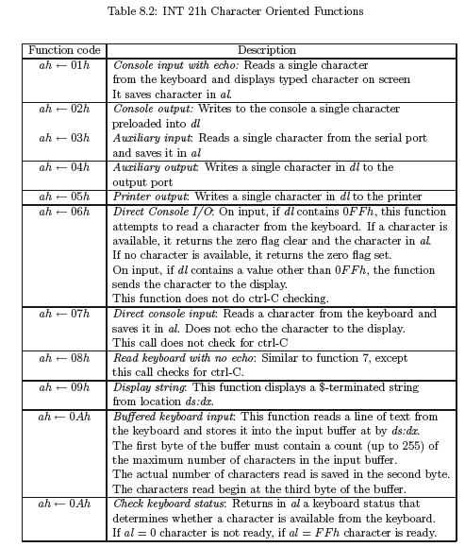

Slide 14
INT16: Keyboard Programming
  Function 01: check for a key press without waiting for the user
    AH = 01
    Upon execution ZF = 0 if there is a key pressed
  Function 00: keyboard read
    AH = 00
    Upon execution AL = ASCII character of the pressed key Note this function must follow function 01

Slide 15
Interrupt Vector Replacement
  The temporary replacement of existing handlers is carried out by the following general steps:
    1. Fetch old interrupt vector,
    2. Save it,
    3. Insert new vector, and
    4. Restore the old vector after execution
  Using int 21h functions:
    1. To get the old pointer the code function 35h is pre-loaded into the ah register; the interrupt type n is also pre-loaded into the al register. The interrupt call (int 21h) returns the old vector in the pair es:bx.
    2. The old vector now in es:bx is saved into the stack or into a memory location determined by the user.
    3. Before an interrupt call is made to insert the new vector, the user pre-loads ah with the function code 25h, the register al with the interrupt type n, and the pair ds:dx with the pointer to the user’s interrupt handler.
    4. After the handler executes, the old interrupt vector is restored by implementing an insertion into the IVT as in step 3.

Slide 16
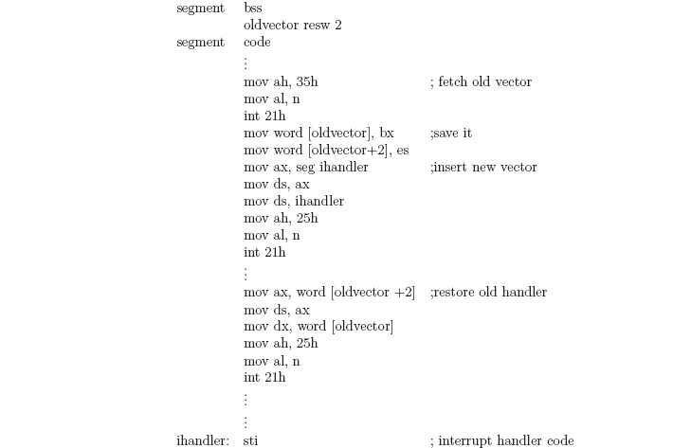
  A possible code sequence using int 21h:

Slide 17

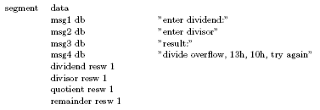
  Direct access
    Example: the handler for int 0 is executed when a division overflow occurs. A reason to replace the vector is to avoid the return to the operating system each time the interruption occurs. A possible implementation of an interactive handler is outlined as follows:

Slide 18
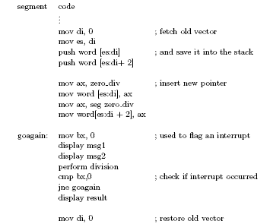

Slide 19
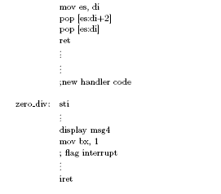

Slide 20
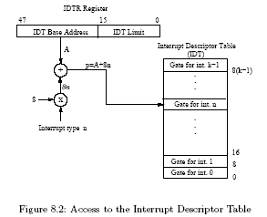
Interrupts in the IA32 Processors

Slide 21
  In protected mode the cpu also uses the interrupt type to index the IDT as shown in Fig. 8.2.
  The IDT in this case consists of up to 256 eight-byte entries.
  Each entry contains an interrupt gate descriptor with information that includes the segment selector and the offset needed to locate the interrupt handler.
  The IDTR provides the base address of the IDT and the interrupt type multiplied by eight provides the location of the interrupt vector.
  The cpu response to an interrupt/exception request is summarized as follows:
    1. Pushes the eflags register:
      esp ← esp − 4; [esp] ← eflags
    2. Disables interrupts by clearing the interrupt flag in the eflags register (cli) From this point on, the cpu will not permit another interrupt. Also the trace flag is cleared (TF ← 0) to prevent instruction tracing interfere with the cpu interrupt response
    3. Pushes the return address:
      esp ← esp − 4 ; [esp] ← cs
      esp ← esp − 4; [esp] ← eip

Slide 22
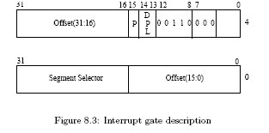
    4. Combining the IDT base address (A) from the IDTR and the interrupt type n as shown in Fig. 8.2, an index p = A + 8n where 0 ≤ n ≤ k, is calculated to access the interrupt gate for int n.
    5. The interrupt gate is a 64-bit entry in the IDT with a format as shown in Fig. 8.3. Among other information bits, it contains the segment selector and an offset that are loaded into cs:eip:
        cs:eip ← idt₆₄[p]
    6. The actual segment of the interrupt handler is now accessed from the Global Descriptor Table (GDT) using the 13-bit segment selector in the cs register. The physical address where the interrupt handler is located is shown in Fig. 8.4.

Slide 23
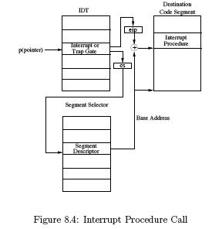

Slide 24
The interrupt handler performs the following steps:
  1. Interrupts are re-enabled. The first instruction of the interrupt handler (sti)
  performs the following operation: IF ← 1
  2. The contents of all working registers are saved into the stack,
  3. The handler executes the code that provides the service requested,
  4. All working registers are restored,
  5. The handler executes an interrupt return (iret) which
    • Restores the return address into cs:eip:
        eip ← [esp]
        esp ← sp + 4
        cs ← [esp]
        esp ← sp + 4
    • Restores the contents of the flags register (popf):
        Flag register ← [esp]
        esp ← esp + 4

